Slide 1


FULL STACK WEB DEVELOPMENT WITH DJANGO
Lecture 13

Slide 2

Today’s Agenda
Developing Our Django App
Loading Static Files
Example

Slide 3
What Are Static Files ?
So far we’ve used templates to insert simple text.
But we don’t always just want text, what about other types of media, for example, displaying images ?
Or we may also want to style our HTML template page with some CSS or make it functional using JS.
In the world of Django, we refer to these files as Static Files as they don’t change frequently

Slide 4
How To Use Static Files ?
Using static files is almost same as using templates with few extra steps:
Activating Django Environment in VS Code
Creating a Django Project in VS Code
Creating the app
Activating the app
Create the templates directory structure.
Create the static directory structure
Configuring settings.py for templates
Configuring settings.py for static files
Create the HTML file inside the template directory
Use special template tags in the HTML file to load the static data
Creating the view to render the template
Configuring the View in Url
Running the server
Opening the page in browser

Slide 5
Performing Steps 1 To 5 and 7
Create a folder called myeighthvsdjangoproject in djangoexamples.
Load it in the VS CODE
Create a django project called templateproject6 by using the command:
django-admin startproject templateproject6
This will create the outer project folder called templateproject6 and inner app folder also by the same name

Slide 6
Performing Steps 1 To 5 and 7
Now go to the outer project folder templateproject6 and create an app called templateapp6 by using the command:
django-admin startapp templateapp6
Now create a folder called templates in the outer project folder called templates and inside templates create a folder called templateapp6 and within it create a file called home.html
Finally update settings.py so that it contains the name of our app and the template directory path

Slide 7
Performing Steps 1 To 5 and 7
Code:
INSTALLED_APPS = [
'django.contrib.admin',
'django.contrib.auth',
'django.contrib.contenttypes',
'django.contrib.sessions',
'django.contrib.messages',
'django.contrib.staticfiles',
‘templateapp6',
]

Slide 8
Performing Steps 1 To 5 and 7
Code:
TEMPLATES = [
{
'BACKEND': 'django.template.backends.django.DjangoTemplates',
'DIRS': [os.path.join(BASE_DIR,'templates')],
…..
}

Slide 9
Performing Steps 1 To 5 and 7
Make sure that uptill now your project and app folders look as shown on the next slide

Slide 10
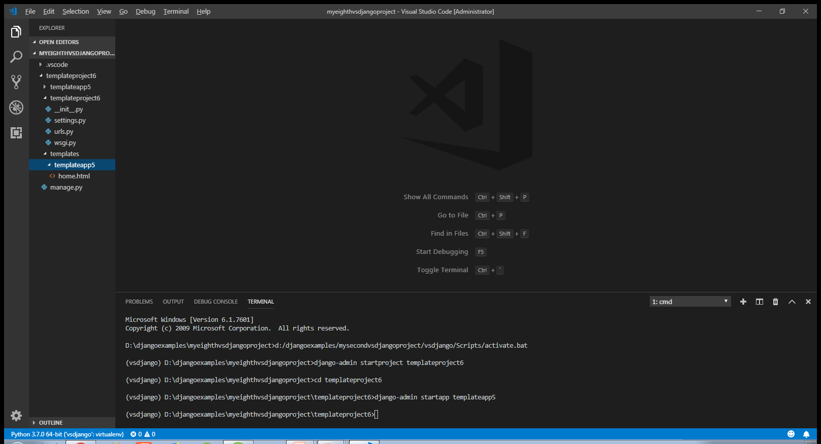
Performing Steps 1 To 5 and 7

Slide 11
Performing Steps 6,8 And 10
After doing the initial required steps ( 1 to 5 and 7) we now need to perform steps for managing static files
For this we just have to perform 3 extra steps which are:
Create the static directory structure
Configuring settings.py for static files
Use special template tags in the HTML file to load the static data

Slide 12
Step 6-Creating Static Directory Structure
To create static directory structure we have 2 options:
Create a folder called static at the project level and place the static files there
OR
Create a folder called static at the app level and place the static files there

Slide 13
Step 6-Creating Static Directory Structure
We use the first approach when we want to share some static files across all the apps of our project , for example for every page in all the apps we want to use same fontsize and font color.In this case we should create project level static directory.
However if we want to have different settings for pages of different apps then we should go for app level static dir. For example we want different background colors for different apps home page, then we should go for app level static dir

Slide 14
Step 6-Creating Project Level Static Directory Structure
To create a project level static directory structure we must do the following:
Create a folder called static inside the project level directory
Within the static folder create a folder called images and add some image to it.
Similarly to store css files , we must create a css subdirectory in the static directory at the project level and place our .css files there.
Same thing applies to js files also

Slide 15
Step 6-Creating Project Level Static Directory Structure
So in our project we must create a folder called static inside the outer project folder called templateproject6
Now in this static folder , we must create a subdirectory called images and place an image (called myself.jpg) there.
After doing this the project or app folder structure should appear as shown in the next slide:

Slide 16
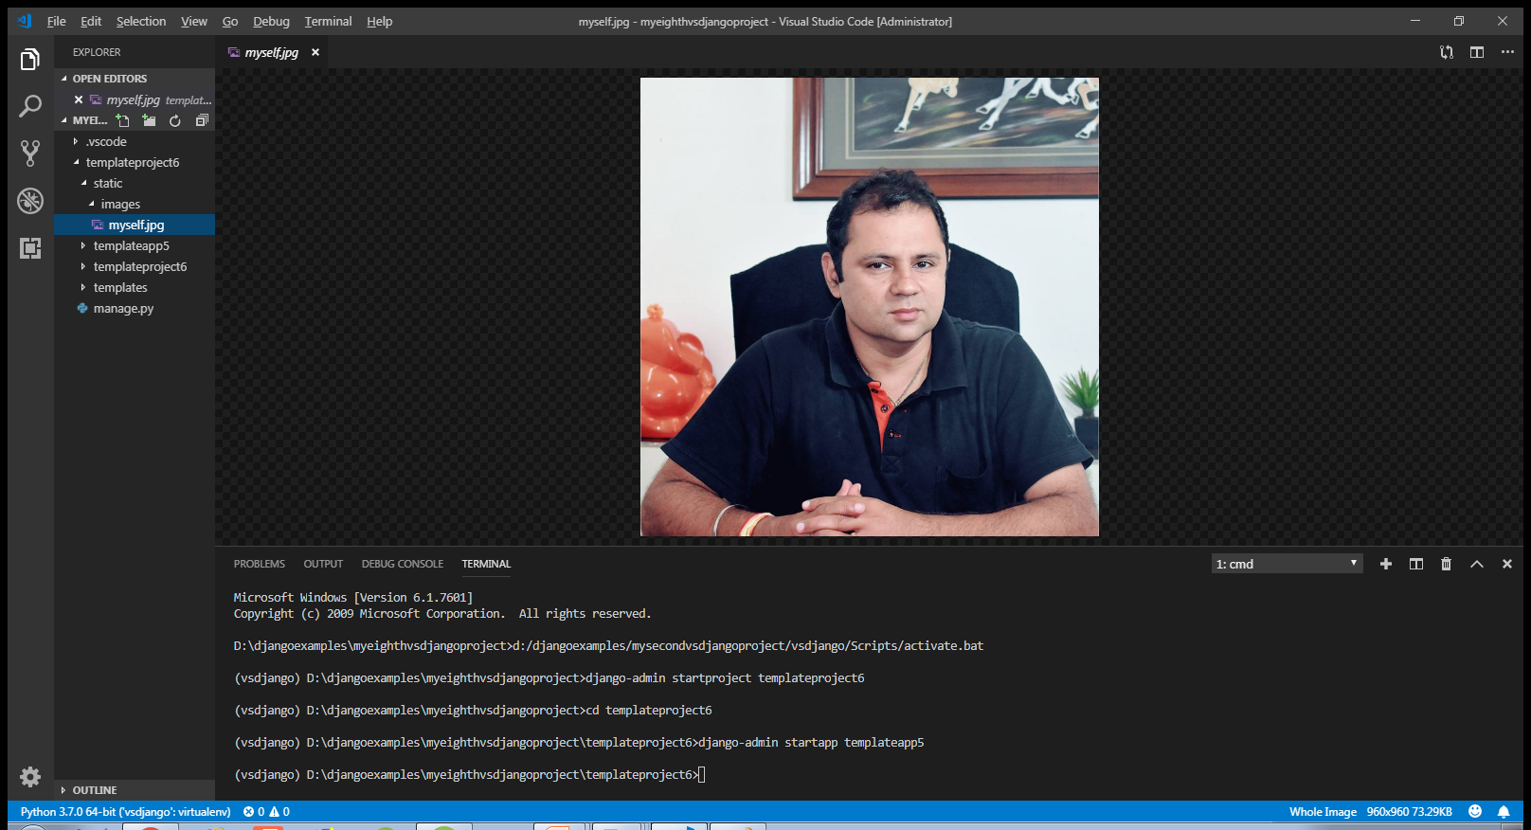
Step 6-Creating Project Level Static Directory Structure

Slide 17
Step 8-Configuring settings.py
Like templates , in case of static folder also we need to inform Django about this because by default Django always looks for static files in the app level folder.
To do this we need to do the following:
Open the file settings.py
Create a list called STATICFILES_DIRS
Add the path to the “static” directory as an entry in this list

Slide 18
Step 8-Configuring settings.py
Code:
STATICFILES_DIRS=[os.path.join(BASE_DIR,'static'),]

Slide 19
Step 10- Use Template Tags To Load Static Data
Now , in our home.html which is in templates/templateapp5 folder we must use some special template tags to load static data.
There are 2 tags to be used:
The first is the {% load staticfiles %} tag which tells Django to load static content
The next tag is "{% static "path to the image" %}" which is used in the src attribute of the <img> tag to pass the path to the image

Slide 20
Step 10- Use Template Tags To Load Static Data
<!DOCTYPE html>
<html lang="en">
<head>
{% load staticfiles %}
<title>Loading Static Data</title>
</head>
<body>
<h1> Hello, This is myself!</h1>
<img src="{% static "images/myself.jpg" %}" >
</body>
</html>

Slide 21
Performing Steps 11 and 12
Finally to make this application functional we need to add code to views.py and both the ursl.py file as before
So we need to perform final 2 steps:
Creating the view to render the template
Configuring the View in Url

Slide 22
Step 11- Creating The View
Open the views.py file in the templateapp5 folder and write the following code which calls the template file and returns it to Django
views.py
from django.shortcuts import render
def homePageView(request):
return render(request,'templateapp5/home.html')

Slide 23
Step 12- Configuring The View In Url
After creating and updating the views.py as shown in the previous slide we perform the next usual step which is configuring the urls
As usual we do this by configuring our URLs at 2 places:
Inside the templateapp5 directory’s urls.py file
Inside the site’s main urls.py

Slide 24
Step 12- Configuring The View In Url
In the VS Code create a new file called urls.py in the templateapp5 folder and write the following code in it.
Code (templateapp5/urls.py):
from django.urls import path
from . import views
urlpatterns = [
path('', views.homePageView, name ='index'),
]

Slide 25
Step 12- Configuring The View In Url
In the VS Code open the file called urls.py in the templateproject6 folder and update the code in it as shown below in green.
Code (templateproject6/urls.py):
from django.contrib import admin
from django.urls import path,include
urlpatterns = [
path('admin/', admin.site.urls),
path('',include('templateapp5.urls')),
]

Slide 26
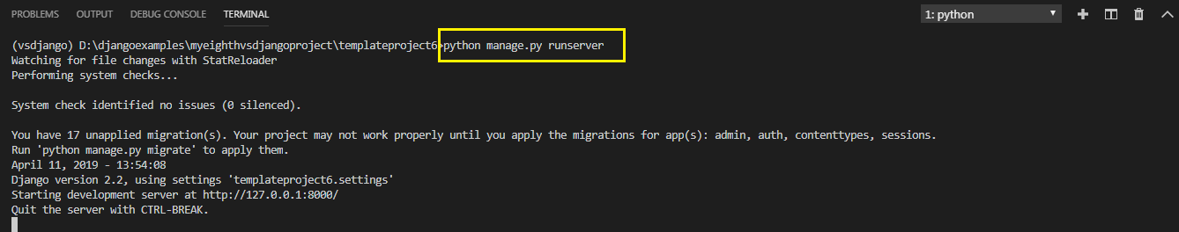
Step 13:Running The Server
To run our new templateapp5 , go to the folder templateproject6 by using cd command and type the runserver command in VS Code terminal
cd templateproject6
python manage.py runserver.
The server runs and we’ll see output like the following output in the terminal window:

Slide 27

Step 14: Opening The Page
Ctrl+click the http://127.0.0.1:8000/sca URL in the terminal output
window to open default browser to that address. Now we should see the
template page with the image myself.jpg loaded

Slide 28

Exercise
Modify the previous app so that the tag <h1> now renders in red color .
Make sure your output matches with the screenshot shown on the next slide
Use css file called mystyles.css and load it using the concepts learnt

Slide 29

Exercise

Slide 30
Solution
We just need to make 3 changes:
Create a folder called css inside the folder called static containing the file called mystyle.css with the following code:
static/css/mystyle.css
h1
{
color:red;
}

Slide 31
Solution
In the home.html file add <link> tag to load the css file.
In the href attribute of the <link> tag use the static tag to mention the path of the css file mystyle.css.
static/templates/templateapp5/home.html
<link href="{% static 'css/mystyle.css' %}" rel="stylesheet"
type="text/css">

